Slide 1
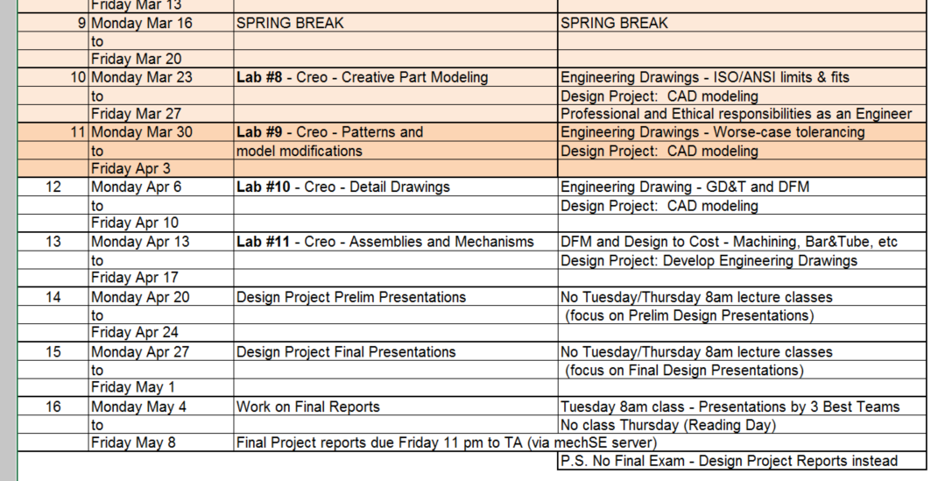
Lecture Class Slide Presentation 3-31-2020
Its been a bit intense here with our MechSE department COVID-19 emergency response involvement. The exploded view CAD model you see in this Press Release is Creo running from my laptop; thought you might like a little encouragement…it can be very rewarding having CAD skills, so please persevere! ☺
Watch the little video, in the press release – our ventilator was designed, 3D printed and successfully pumping the test lung in just 5 days.
So, back to CLASS today, lets start as its Tuesday with a little recap and look at the class schedule below. Week 11 now, we will continue with tolerancing of engineering drawings in lecture class and for your team projects you should be beavering away on your CAD modeling work. In lab, you will be learning about patterns and how to make changes to your models.
Please read through the powerpoint slides and complete Lecture Class Assignment #11
And don’t forget to complete the Lecture Class assignment within the next 3 days for full credit – you can type within powerpoint, or print on paper then either scan it or take a picture with your smart phone

Slide 2
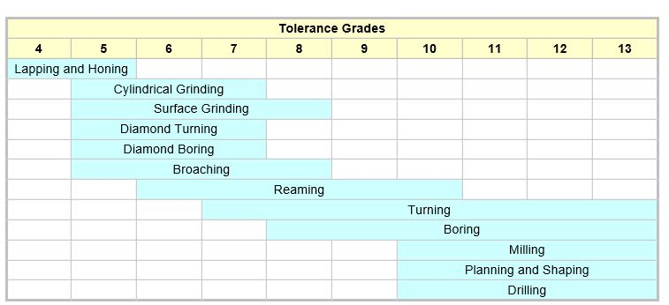
Typical IT tolerance capability by machining process

Slide 3
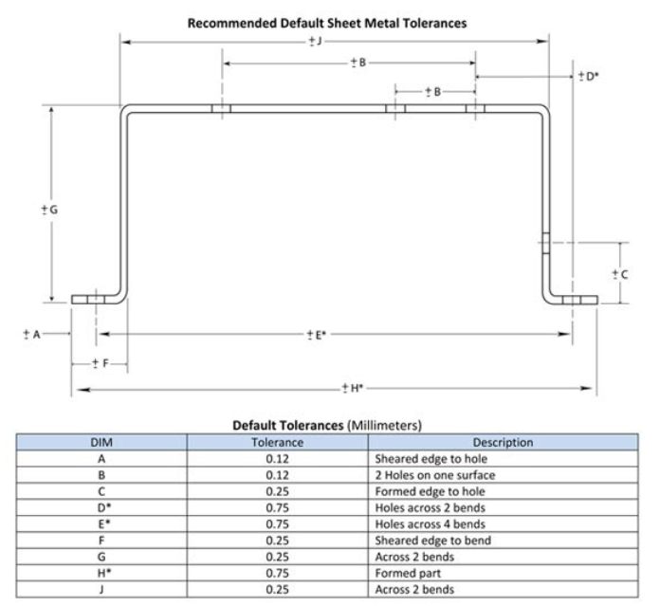
Sheet Metal Parts – Typical Tolerance Capability
http://www.vista-industrial.com/sheet-metal-tolerances.php

Slide 4
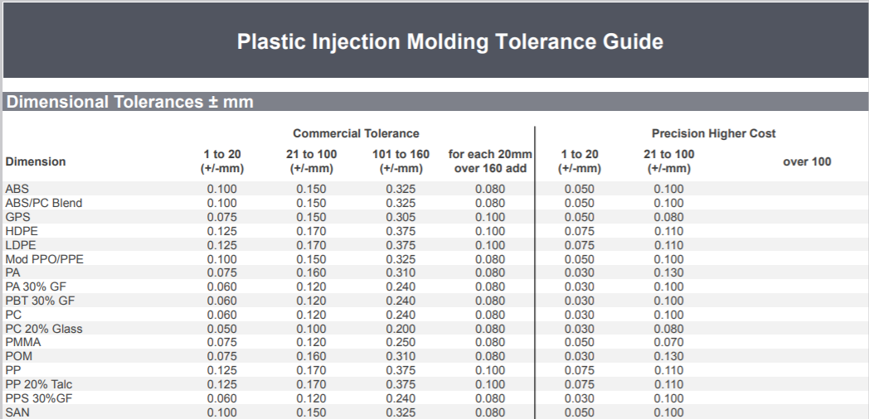
Injection Molding – Typical Tolerance Capability
Dimensional Tolerances
https://www.starrapid.com/wp-content/uploads/2016/11/Star-Rapid-Plastic-Injection-Molding-Tolerance-Guide.pdf

Slide 5
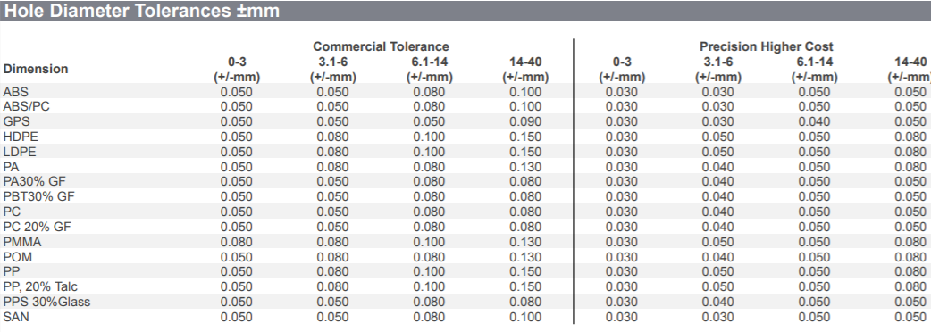
Injection Molding – Typical Tolerance Capability
Diameter of holes
https://www.starrapid.com/wp-content/uploads/2016/11/Star-Rapid-Plastic-Injection-Molding-Tolerance-Guide.pdf

Slide 6
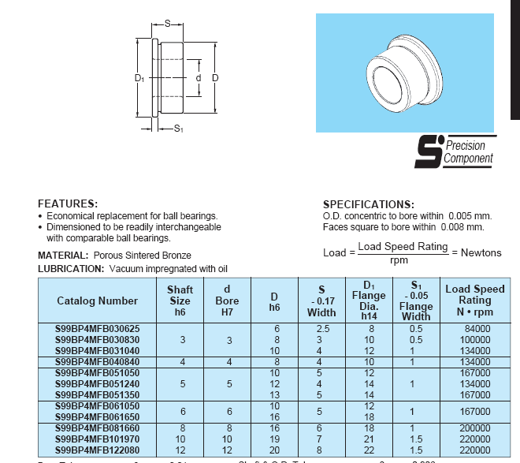
Flanged Sintered Bronze Plain Bearing

Slide 7
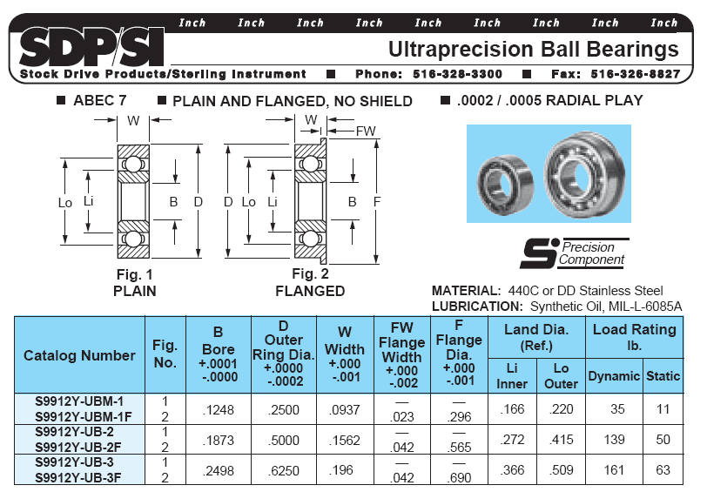

Slide 8
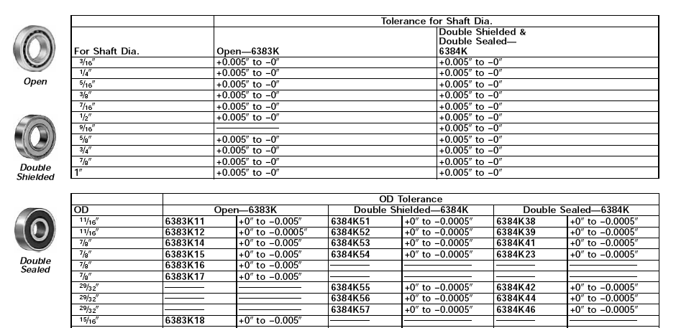
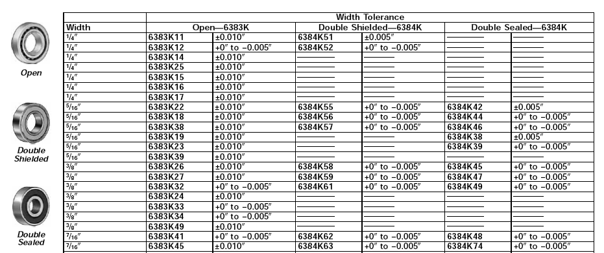
Click here and look around the McMaster-Car catalog to find these bearings and much more for your projects

Slide 9
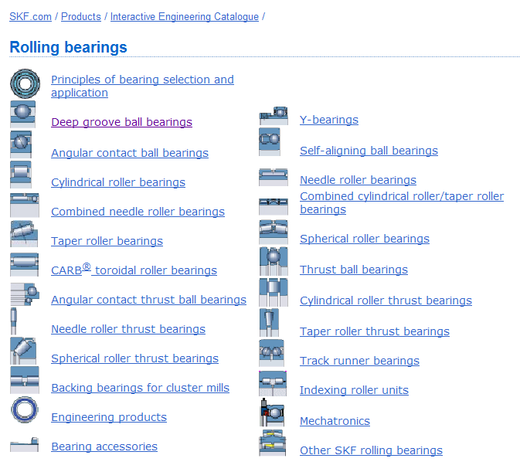
On-line Interactive Catalogs
Click here and look around at the SKF website – find CAD models and specs to use for your projects perhaps

Slide 10
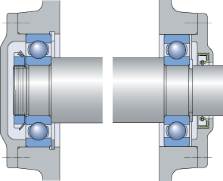
Ball Bearing Design Considerations
Allow float for thermal expansion and reduced axial tolerance requirements
Click on pic to select SKF catalog page

Slide 11
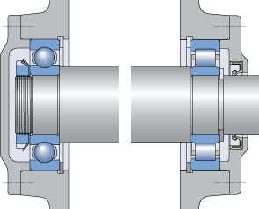
Roller Bearing Design Considerations
Roller Bearing provides float for thermal expansion and reduced axial tolerance requirements

Slide 12
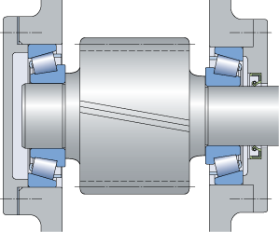
Taper Roller Bearings for high axial and radial loads
Preload to remove all axial clearance/play in the bearing

